Slide 1

aspiring minds university
Introduction to Statistical Learning
Module 2a
Supervised Learning

Slide 2
Inference Problem
Supervised
There is some supervising output – predict or estimate some output value based on some input value ( both part of the data)
Unsupervised
There is no supervising output – we only try to learn relationships in the data and the structure of the data
Classification
Given data of predictors and category, build a model that can take the input values and predict the category of the data point
Regression
Given data containing some continuous output determined by input variables, build a model that can predict that output give input values for new point
Clustering
Cluster data points that are similar/ close together; allows one to understand groups

Slide 3
What are we trying to learn?
In supervised learning, lets take the regression setting, we believe that the data contains some output values(Y) that are related to the rest of the attributes, the input values (X1,X2,X3…).
We want to learn the relationship for two reasons
1. Prediction 2. Inference

Slide 4
Output values
Response
Output
Dependent
Variables
Input values
Predictors
Attributes
Independent Variables

Slide 5
We assume that there exists some relationship between the X’s = the predictors = input and Y = response = output.
Let us denote this as,
But! We cant explain everything about Y from the X’s we have, it may be influenced by other factors (more later) and there may be some natural variability. The relationships we try to learn are inherently statistical relationships and not deterministic – that is they are not exactly determined by closed forms but are data collected experimentally.
Think about measurement error, variance due to conditions etc. So,
Learning Equation

Slide 6
Example : Boston Housing Data
Download the files housing_data.txt and housing.names
Predictors = x’s = CRIM,ZN,INDUS,CHAS,NOX RM, AGE,DIS,RAD,TAX ,PTRATIO,B,LSTAT
Response = Y = MEDV

Slide 7
Goal: We are trying to learn f, the relationship so that we can either make predictions or make inferences [two outputs] .
Prediction: In a prediction setting, we [might not]don’t care about the form of f ! We just want to learn f well so that it makes a good predictor. We may use complicated techniques – SVMs, Neural Networks. The [predicted] results may not be easily interpretable – we can predict something, but we cant accurately say why such relationships occur.
Inference: In the inference setting, we care much more about understanding the underlying dynamics in a model. Methods are simpler – linear, regularized linear. Field where this is important – Econometrics, market intelligence etc.

Slide 8
Ex 2a: Supervised Learning
Work through this exercise and make sure you understand everything!

Slide 9
More complicated = more flexible = less interpretable Eg: Neural nets, SVMs, Generalized Additive Models
The interpretability-flexibility trade-off
Less complicated = less flexible = more interpretable
Eg: Linear regression, regularized linear regression

Slide 10
Estimator
We have a sample of (X,y) [predictor-response] values from the population that are related by f(X) = y.
When we try to learn f, we will not exactly get f since there is always some error due to sampling, imperfect assumptions and so we can only estimate f.

Slide 11
Estimator – contd.
So the model, the estimator, we build is denoted as
And we get the relationship
where Y (capped) is predicted response

Slide 12
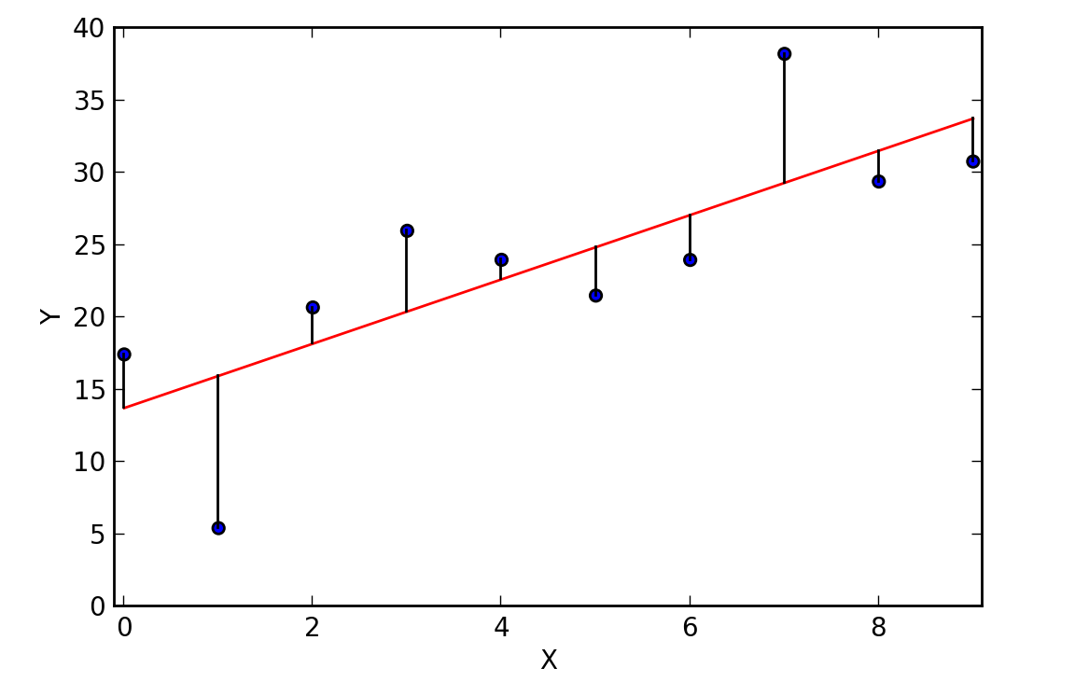
How well does the model do?
Residuals

Slide 13

How well does the model do?
We use MSE = mean-squared error to evaluate how good a model is. It gives an idea about the average error of the estimator.
Squared so that +ve and –ve residuals do not cancel each other out
Summed and meaned so that we get an idea about the average

Slide 14
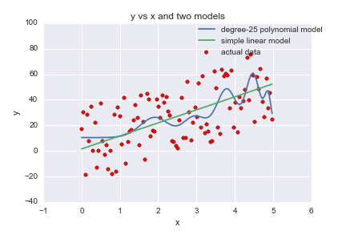
Bias - Variance Tradeoff An example

Slide 15
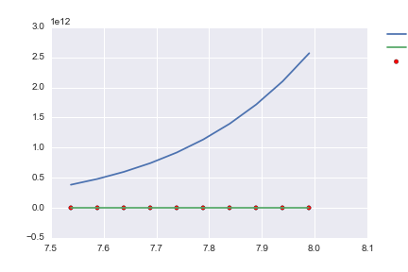

Slide 16
Bias – Variance Trade-off
Variance = change in predicted value of f(X) is the sample is changed and the model is made again
Bias = expected error due to difference in predicted value and true value

Slide 17
Bias- Variance Trade- off
More complicated = Low Bias = High Variance
Less complicated = Higher Bias = Low Variance

